Slide 1
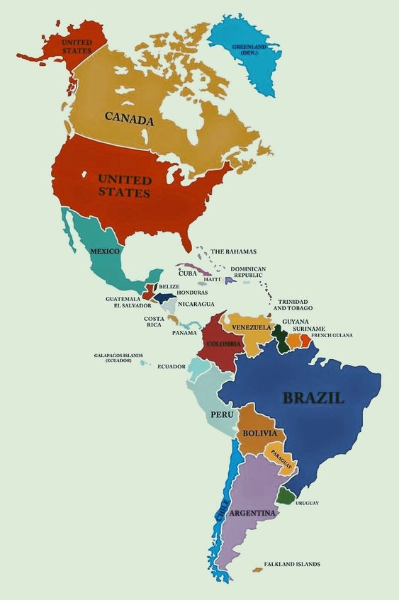
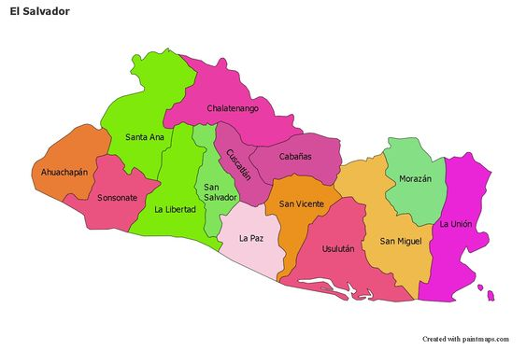
Proficiency PT program overview EQEP El Salvador
MINISTRY OF HEALTH
ITS/VIH PROGRAM UNIT
CLINICAL LABORATORY OFFICE
AUGUST 2024

Slide 2
SAMPLES USED FOR EXTERNAL QUALITY EVALUATION PROGRAM PEEC EL SALVADOR AS OF JUNE 2019
DTS= Dry Tube Sample
EQEP Reference Laboratories
Decentralized 5 Health Regions
DSS= Dialyzed Serum Sample
Public Health Surveillance Laboratory LVSP

Slide 3
EXTERNAL QUALITY EVALUATION PROGRAM CYCLE EQEP EL SALVADOR
6.- Registration
1.- Call for decentralized EQEP establishments (11 days)
2.- LVSP raw material request
Logistics and request for supplies and materials to be used.
4.- Update and Define SNIS network
5.- Evaluation criteria, percentages and timeframes
7.- Panel production workshop trained personnel
8.- Delivery of CTRLC panels 5 health regions (Distribution to each facility)
9.- Processing of panels by local levels
10.Sending and receiving results from the local levels to CTRLC 5 regions and these to the decentralized establishments.
11.- Evaluation of results and preparation of feedback report
12.- Satisfaction survey
13.Follow-up and feedback from decentralized facilities and CTRLCs 5 health regions and UITS/HIV supervision team.
14.- Analysis and systematization of data and improvement projects

Slide 4
DECENTRALIZED ESTABLISHMENTS EXTERNAL QUALITY EVALUATION PROGRAM EQEP EL SALVADOR
Rosales National Hospital, Metropolitan Health Region.
San Rafael National Hospital, Central Health Region.
National Hospital of Zacatecoluca, Paracentral Health Region.
Dr. Jorge Mazzini National Hospital of Sonsonate, Western Health Region.
San Juan de Dios de San Miguel National Hospital, Eastern Health Region.

Slide 5
DIAGNOSTIC TESTS OF THE EXTERNAL QUALITY EVALUATION PROGRAM PEEC EL SALVADOR FROM 2019 TO 2024
HIV and
Syphilis
HIV, Syphilis, Hepatitis B, Hepatitis C
HIV, Syphilis, Hepatitis B, Hepatitis C
HIV, Syphilis, HIV/Syphilis Duals Hepatitis B, Hepatitis C
HIV, Syphilis, HIV/Syphilis Duals Hepatitis B, Hepatitis C
HIV, Syphilis, HIV/Syphilis Duals Hepatitis B, Hepatitis C, Cryptococcus

Slide 6
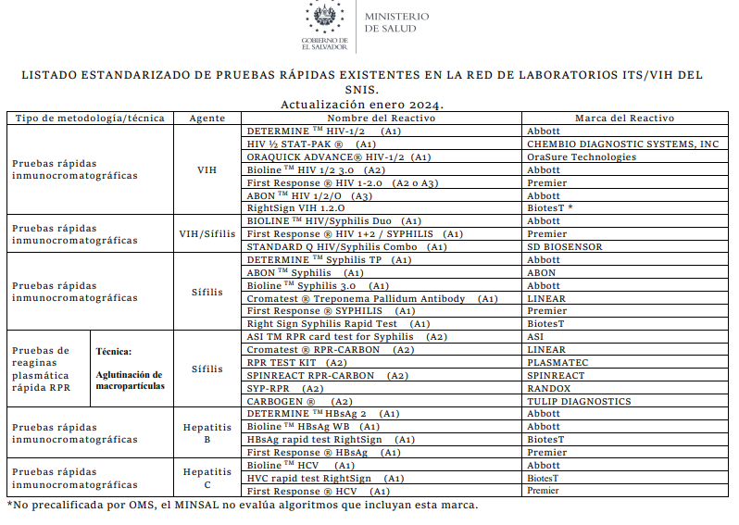
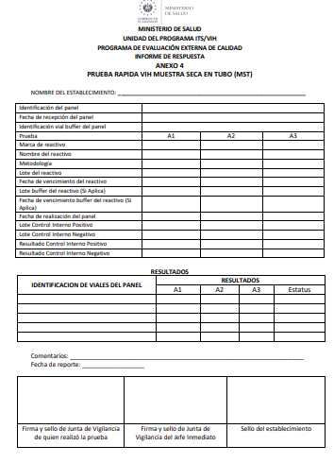
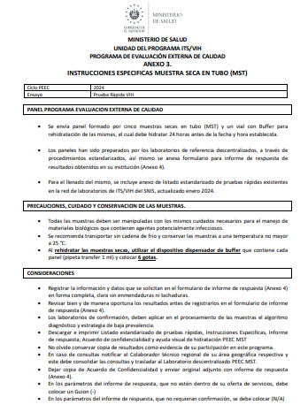
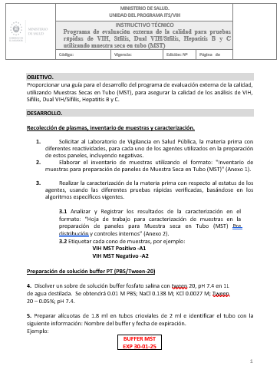

Slide 7
PEEC MST EL SALVADOR

Slide 8
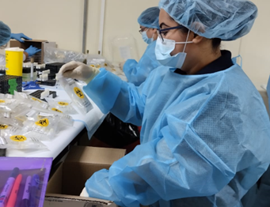
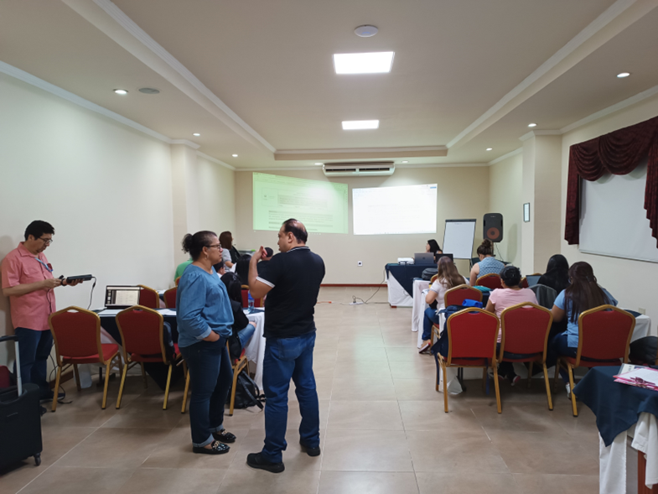
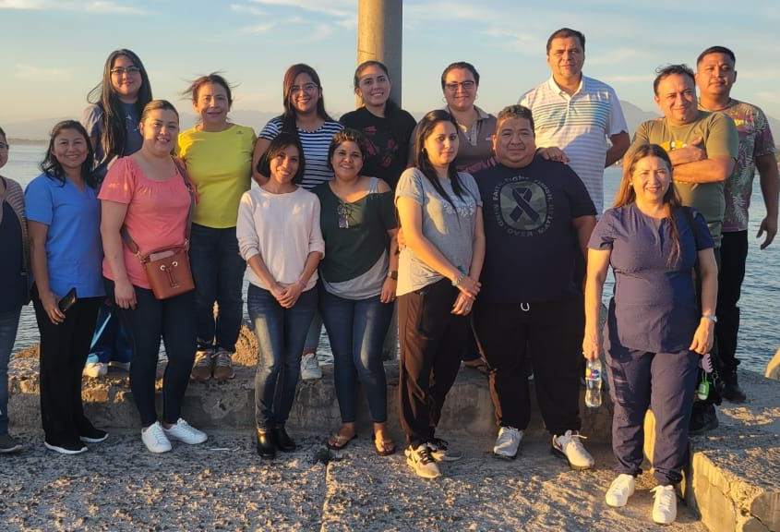
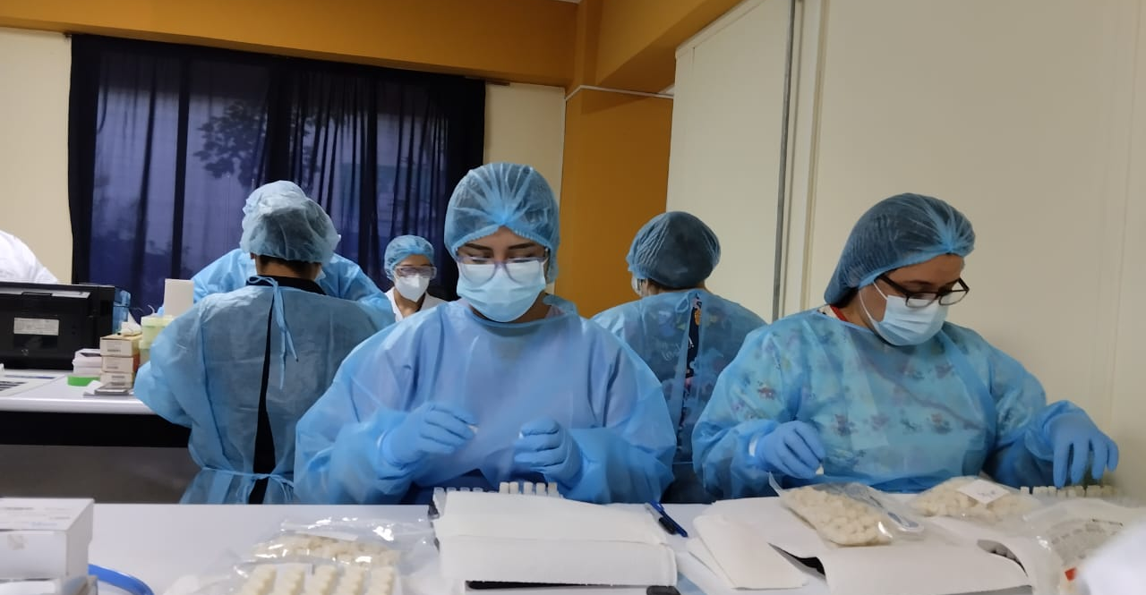
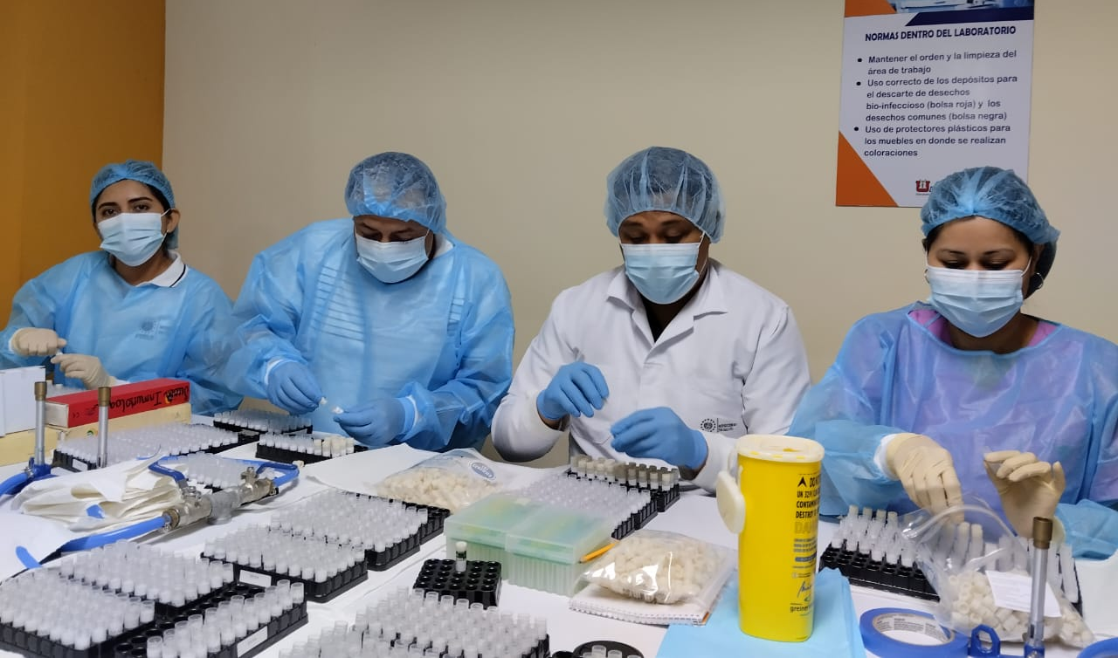
EQEP DTS EL SALVADOR

Slide 9
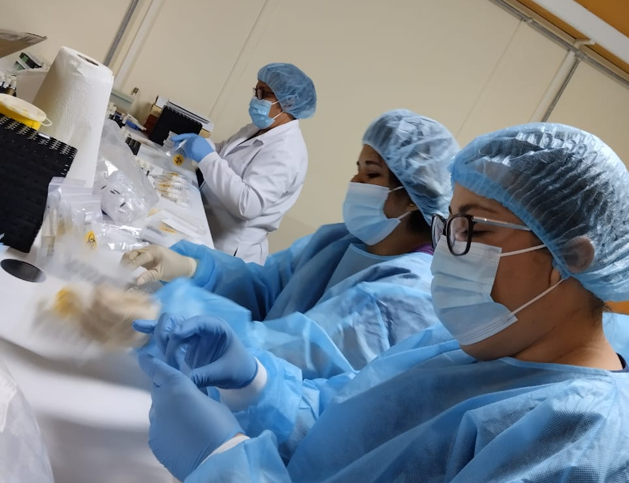
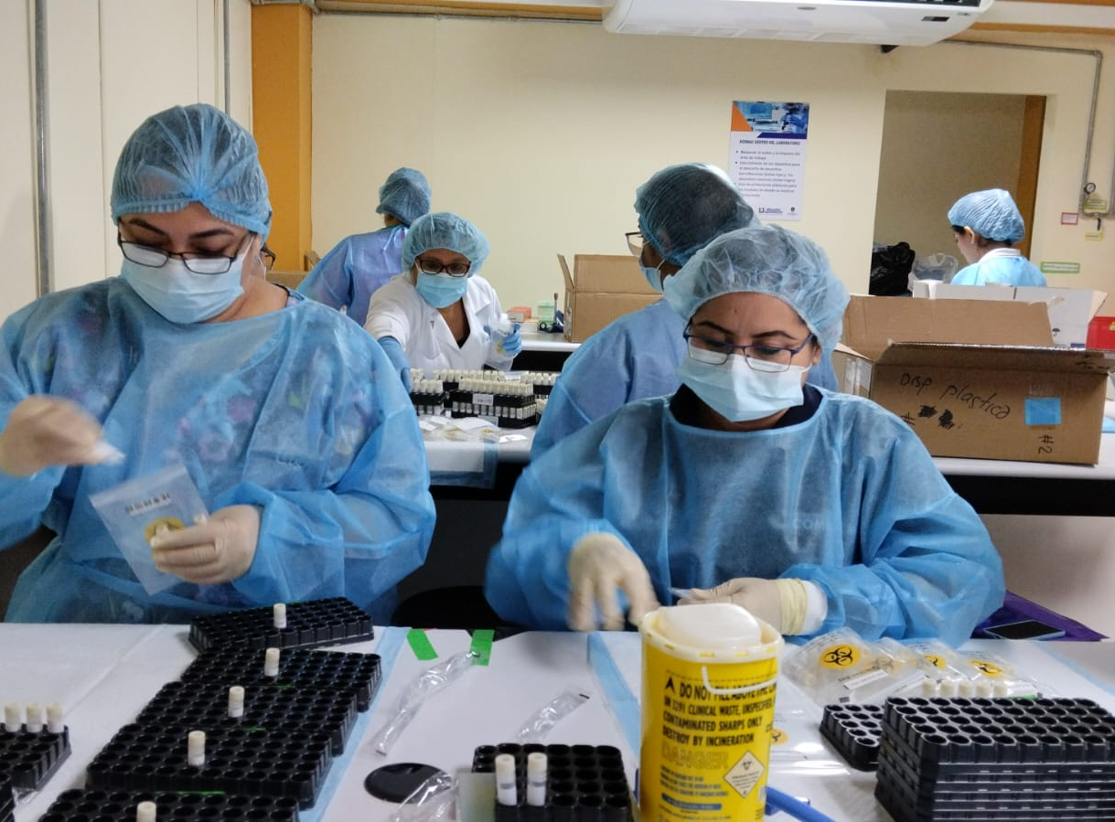
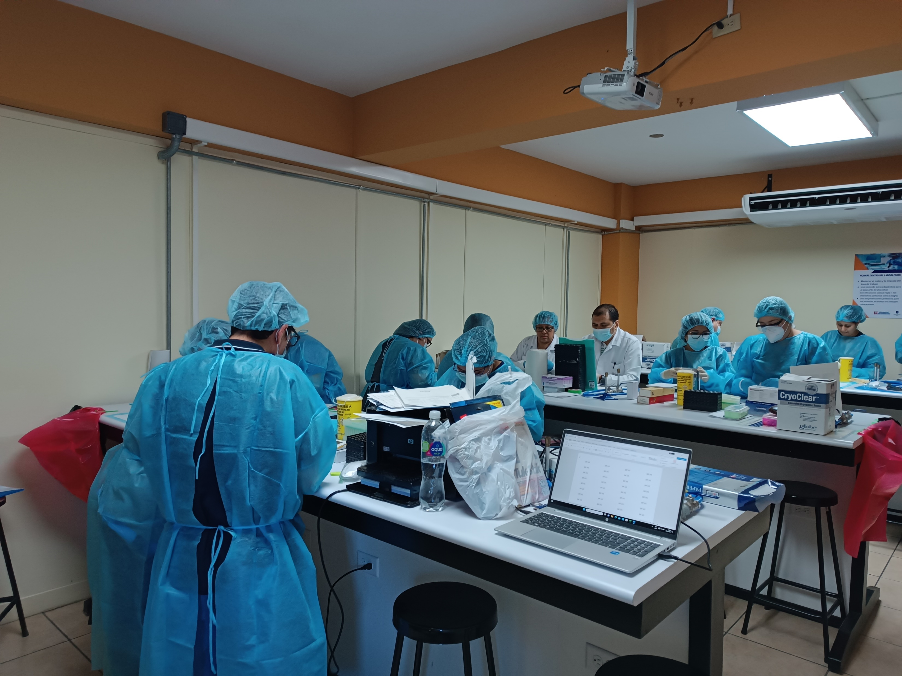
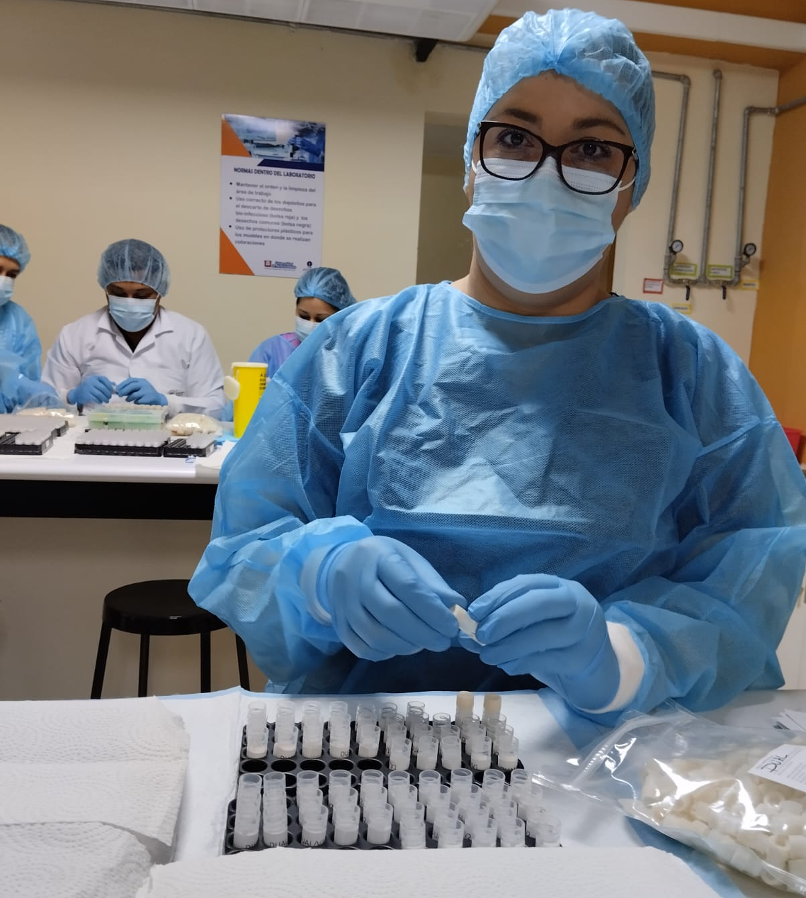
EQEP EL SALVADOR

